Slide 1
Loeblein Physics clicker questions
HS Course Sequence
The Moving Man 3-21
Calculus Grapher 22-32
Vector Addition 33-40
Projectile 41-51
Forces & Motion 56-63
Ramp-Force&Motion 64-70
Maze Game 71-75
Energy Skate Park 76-103
Masses and Springs 104-111
Pendulum 112-119
Gravity and Orbits 120-123
Ladybug Motion 2D 124-132
Lady Bug Revolution 133-140
Gas Properties and States of Matter 141-150
Waves on a String 151-166
Fourier 167-168
Sound 169-187
Wave Interference 188-196
Resonance 197-202
Geometric Optics 203-214
Faraday Law- magnets and induction 215-224
Electric Field hockey & Charges and Fields
225-234
Balloons/Static Electricity & Travoltage
235-243
Density 244-252
Balloons and Buoyancy 253-265
Under Pressure (Fluid Pressure Flow – Pressure tab) 266-275
Circuit Construction Kit 276-296

Slide 2
Plans for using PhET simulation activities in Loeblein’s College Physics
IC In Class Activity; CQ clicker questions; HW homework ; Demo: teacher centered group discussion
Semester 1
Unit 1: Introduction to Motion:
Moving Man IC/CQ
Calculus Grapher HW/CQ
Unit 2: More on motion and Measurement
Vector Addition IC/CQ
Projectile motion IC/CQ
Unit 3: Forces and the Laws of Motion Publishing skills: curve fit, drawing, tables
Forces and Motion: Two activities IC/CQ Ramp- Force and Motion: Two activities IC/CQ
Maze Game: HW/CQ
Curve Fitting: HW
Unit 4: Work, Energy, Momentum and Collisions
Energy Skate Park: Four activities IC/CQ
Masses and Springs: IC/CQ
Collision: HW
Unit 5: Circular Motion and Semester Project
Pendulum: HW/CQ
Gravity Force Lab: IC/CQ
Pendulum: HW
Ladybug 2D: HW/CQ
Ladybug Revolution: HW/CQ
Masses and Springs: HW
Balancing Act: (no activity yet)
Semester 2
Unit 1: Heat and Thermodynamics
Friction: Demo
States of matter: IC/CQ
Unit 2: Waves: Introduction to light and sound
Waves on a String: IC/CQ
Fourier-Making Waves: Three activities IC/CQ/HW
Sound: IC/CQ
Wave Interference: IC/CQ
Resonance: IC/CQ
Bending Light: IC
Geometric optics: IC/CQ
Unit 3: Electric and Magnetic Forces and Fields
Faraday’s Electromagnet Lab: IC/CQ
Electric Field Hockey with Charges and Fields: IC/CQ
Balloons and Static Electricity John Travoltage: Demo / CQ
Gravity and Orbits: CQ
Unit 4: Fluid Mechanics, Semester Projects
Density: IC/CQ
Buoyancy: IC
Balloons and Buoyancy: IC/CQ
Under Pressure: IC/HW/CQ
Estimation: HW
Unit 5: Current, Resistance, Circuits, and Circuit Elements
Charges and Fields: Demo
Capacitor Lab: HW
Circuit Construction Kit: Three activities IC/CQ

Slide 3
The Moving Man
Activity
Trish Loeblein phet.colorado.edu
Learning goals: Students will be able to accurately interpret and draw position, velocity and acceleration graphs for common situations and explain their reasoning.

Slide 4
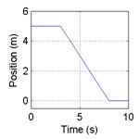
Below is a graph of a balls motion. Which of the following gives the best interpretation of the ball’s motion?
Notes:
Say “Draw graph on paper”

Slide 5
The ball moves along a flat surface. Then it moves forward down a hill, and then finally stops.
The ball doesn’t move at first. Then it moves forward down a hill and finally stops.
The ball is moving at constant velocity. Then it slows down and stops.
The ball doesn’t move at first. Then it moves backwards and then finally stops.
The ball moves along a flat area, moves backwards down a hill and then it keeps moving.
Notes:
D

Slide 6
2. Draw a velocity-time graph would best depict the following scenario?
A man starts at the origin, walks back slowly and steadily for 6 seconds. Then he stands still for 6 seconds, then walks forward steadily about twice as fast for 6 seconds.
Notes:
Sketch what you think

Slide 7
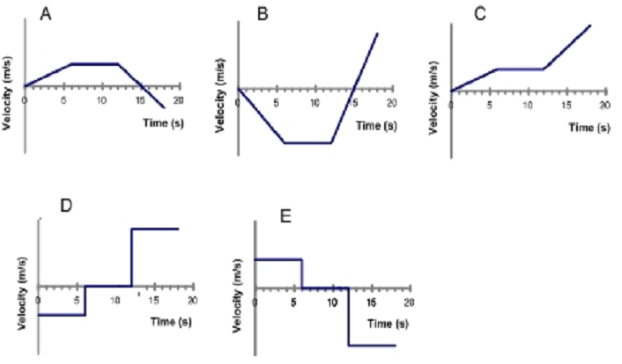
2 Which velocity time graph best depicts the scenario?
Notes:
2 D

Slide 8
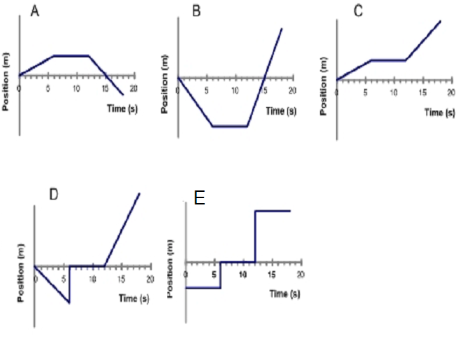
3. For the same scenario as # 2, which position-time graph best depicts the motion?
Notes:
3B

Slide 9
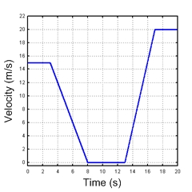
4 A car is traveling along a road. Its velocity is recorded as a function of time and is shown in the graph below.
Notes:
Draw graph on paper

Slide 10
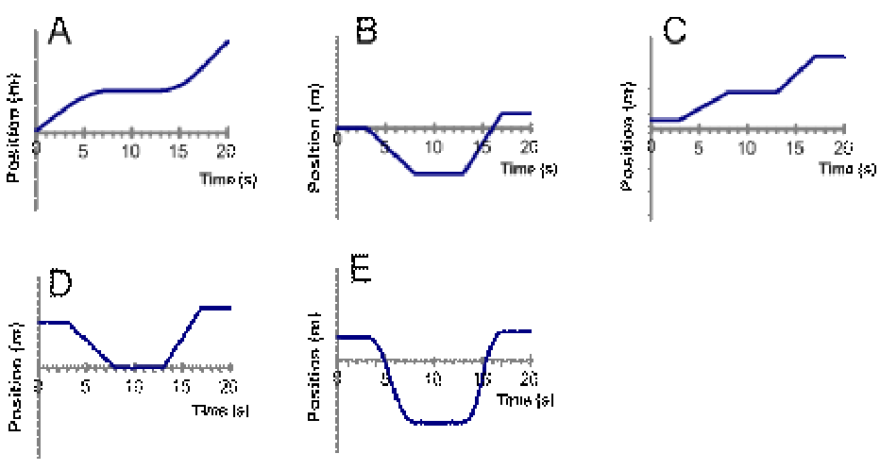
5. Which of the following position-time graphs would be consistent with the motion of the car in question #4?
Notes:
5A

Slide 11
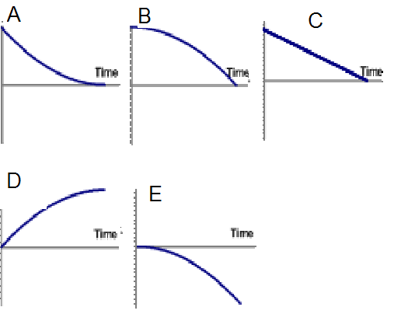
6. A car is moving forward and applying the break. Which position-time graph best depicts this motion?

Slide 12
Stopping Distance. Consider two cars, a 700kg Porsche and a 600kg Honda Civic. The Porsche is speeding along at 40 m/s (mph) and the Civic is going half the speed at 20 m/s. If the two cars brake to a stop with the same constant acceleration, lets look at whether the amount of time required to come to a stop or the distance traveled prior to stopping is influenced by their initial velocity.
Perkins’ Phys1010 Homework 2 University of Colorado
Notes:
These next slides are adapted from Perkins’ Phys1010 Homework 2 activity in Teaching Ideas

Slide 13
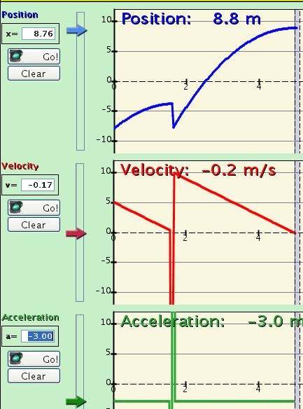
Using Moving man
Select the accelerate option and set the initial velocity, initial position, and an acceleration rate so that the walking man’s motion will emulate that of the car stopping with constant acceleration.
Notes:
In this example, I set the man at x= -8, v=5, a=-3, pressed Go and Pause when the velocity was 0. Then I set man at –8, v=10, a=-3, pressed Go and Pause when the velocity was 0. I plan to show this with the simulation running, but I made the slide to help me remember settings that work well.

Slide 14
7. If you double the initial walking speed, the amount of time it takes to stop
is six times longer
is four times longer
is two times longer
does not change
is half as long
Notes:
C

Slide 15
8. If you double the initial walking speed, the man walks … before coming to a stop.
Half the distance
four times farther
three times farther
two times farther
The same distance
Notes:
B

Slide 16
9. If you triple the initial walking speed, the walking man goes … before stopping.
one third as far
One ninth as far
three times farther
six times farther
nine times farther
Notes:
e

Slide 17
Notes from Perkins’ homework
While moving man is useful to answer this question, equations give us the same result.
Use Velocity = Initial velocity + acceleration x time
or acceleration = (change in velocity)/(time elapsed)
which is the same as (time elapsed) = (change in velocity)/acceleration.
So it will take 2 times as long to stop if the initial velocity is 2 times larger and the acceleration is the same.
distance traveled = (initial velocity) x time + (1/2 x acceleration x time x time)
Adapted From Perkins at University of Colorado

Slide 18
10. If the acceleration is zero, the man must be standing still.
True
False
Notes:
B

Slide 19
11. Velocity and acceleration are always the same sign (both positive or both negative).
True
False
Notes:
B

Slide 20
12. If the speed is increasing, the acceleration must be positive.
True
False

Slide 21
Notes from Perkins’ homework
A negative acceleration indicates that the acceleration points in the negative direction. Under these conditions, if the man is moving in the positive direction, the negative acceleration will be acting to slow him down (velocity and acceleration point in opposite directions). If the man is moving in the negative direction, the negative acceleration will be acting to speed him up (velocity and acceleration point in the same direction).
Adapted From Perkins at CU 1010 course at University of Colorado

Slide 22
Calculus Grapher for Physics
Activity
Learning Goals: Students will be able to:
Use the language of calculus to discuss motion
Given a function sketch the derivative, or integral curves
Open Calculus Grapher and Moving Man before starting presentation
Trish Loeblein July 2009
phet.colorado.edu

Slide 23
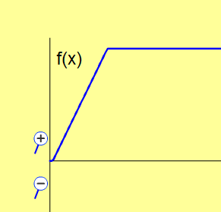
1. A car started from a stoplight, then sped up to a constant speed. This function graph describes his..
Position
Velocity
Acceleration
Notes:
B

Slide 24
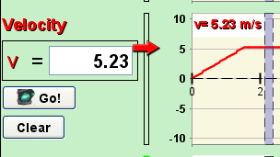
Use Moving man to show this: I set the acceleration at about 3 then paused the sim by the time the man got to the 4 spot, then I changed the acceleration to 0. If you have Moving man open with this type of scenario, you can use the grey bar to show that the speed was zero increasing and then constant.

Slide 25
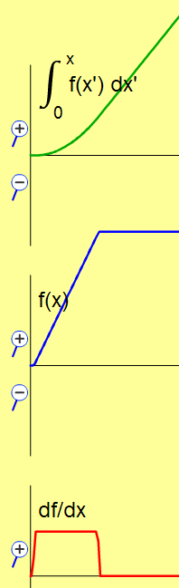
2. To find out how far he traveled, you would use
Integral
Function
Derivative
Notes:
A

Slide 26
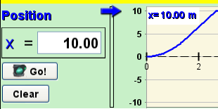
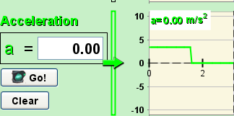
Use Moving Man Replay to show Position is found by the integral curve
Derivative curve shows acceleration
Notes:
B

Slide 27
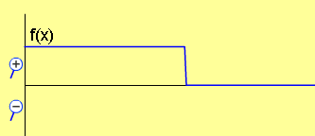
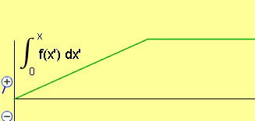
3. Your friend walks forward at a constant speed and then stops. Which graph matches her motion?
A. Position curve
B. Velocity curve
C. Position curve
D. Acceleration curve
E. More than one of these
Notes:
E. The answer is both B and C.

Slide 28
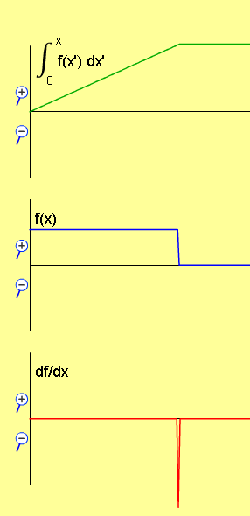
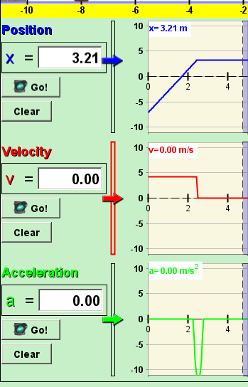
Use Moving man to show this: I set the Man at about -6 position, made the velocity about 4, then paused the sim by the time the man got to the 4 spot, then I changed the velocity to 0. If you have Moving man open with this type of scenario, you can use the grey bar to help.

Slide 29
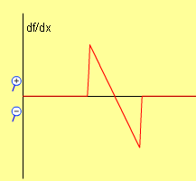
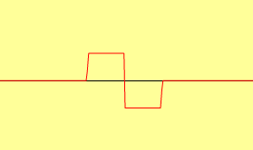
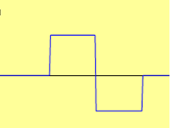
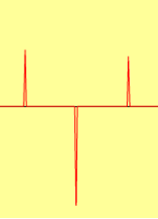
4. Which could be the derivative curve?
A
F(x)
B
C
Notes:
C

Slide 30
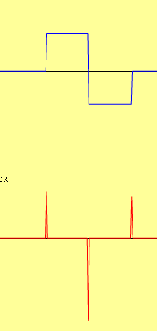
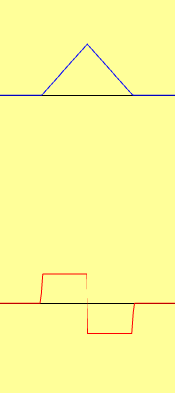
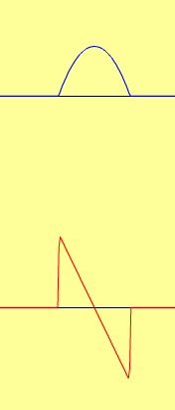

Pedestal Linear Parabola
F(x)
For each case, if the function, F(x) is velocity, what could a possible story for the motion of a person walking?
Notes:
For the pedestal, a person would be standing still, then walk forward, turn around and walk the other way and stop.
For the linear, a person would be standing still, accelerate at a constant rate forward (going faster), then still going forward slowing at a constant rate to a stop.
For the parabola, the story is nearly the same as the linear in that the object is going forward the whole time, but it might be easier to imagine a person driving a car. The car would be not increasing speed up as much, so more like the driver was using the gas all the way. then let up and then used the break more and more .

Slide 31





5. Three race cars have these velocity graphs. Which one probably wins?
A
B
C
D No way to tell

Slide 32
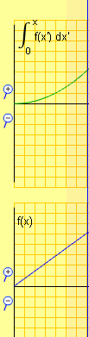
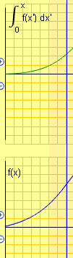

Use integral to tell that the parabolic one traveled farthest
Max value

Slide 33
Vector addition
Activity
Learning Goals: Students will be able to
Explain vector representations in their own words
Convert between the of angular form of vectors and the component form
Add vectors.
Trish Loeblein phet.colorado.edu

Slide 34
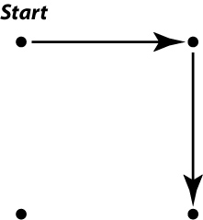
1. For one hour, you travel east in your car covering 100 km .Then travel south 100 km in 2 hours. You would tell your friends that your average speed was
47 km/hr
67 km/hr
75 km/hr
141 km/hr
200 km/hr
Notes:
Adapted from Beale/Franklin
B. The total distance traveled is 200 km and the elapsed time is 3 hours so the average speed is (200 km)/(3 hours)=67 km/hr.

Slide 35
2. For one hour, you travel east in your car covering 100 km .Then travel south 100 km in 2 hours. You would tell your friends that your average velocity was
47 km/hr
67 km/hr
75 km/hr
141 km/hr
200 km/hr
Notes:
Adapted from Beale/Franklin
A. The magnitude of the net displacement is the length of the diagonal which is 141 km by the Pythagorean theorem. The magnitude of the average velocity is then (141 km)/(3 hours)=47 km/hr.

Slide 36
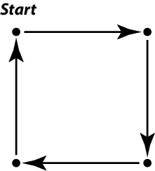
3. You have already traveled east in your car 100 km in 1 hr and then south 100 km in 2 hrs. To get back home, you then drive west 100 km for 3 hours and then go north 100 km in 4 hours. You would say your average velocity for the total trip was
20 km/hr
40 km/hr
60 km/hr
100 km/hr
None of the above
Notes:
Adapted from Beale/Franklin
E none of the above.The net displacement is zero since you are back where you started. Therefore the average velocity is zero.

Slide 37
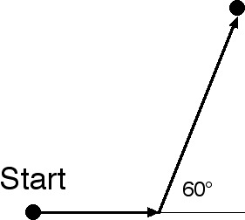
4. You fly east in an airplane for 100 km. You then turn left 60 degrees and travel 200 km. How far east of the starting point are you? (approximately)
100 km
150 km
200 km
300 km
none of the above
Notes:
Adapted from Beale/Franklin
C 200 km.
x=100 km + (200 km)cos(60°)=100 km + 100km = 200 km

Slide 38
5. You fly east in an airplane for 100 km. You then turn left 60 degrees and fly 200 km. How far north of the starting point are you? (approximately)
100 km
130 km
170 km
200 km
none of the above
Notes:
Adapted from Beale/Franklin
C 170 km.y=(200 km)sin(60°)=173 km

Slide 39
6. You fly east in an airplane for 100 km. You then turn left 60 degrees and fly 200 km. How far from the starting point are you? (approximately)
170 km
200 km
260 km
300 km
370 km
Notes:
Adapted from Beale/Franklin
C 260 km By the Pythagorean theorem, the magnitude of the displacement is
sqrt((200 km)²+(173 km)²)=264 km

Slide 40
7. You fly east in an airplane for 100 km. You then turn left 60 degrees and fly 200 km. In what direction are you from the starting point?
South of west
Directly southwest
Directly northeast
North of east
None of the above
Notes:
Adapted from Beale/Franklin
D north of east

Slide 41
Projectile Motion
Activity
Trish Loeblein
June 08
Download the lesson plan and student directions for the lab HERE
There are some screen shots included to illustrate answers, but it would be better to use the simulation during discussion.
phet.colorado.edu
Notes:
Trace with air resistance are red and without are blue

Slide 42
Learning Goals
Predict how varying initial conditions effect a projectile path
These are part of the lesson, but not addressed in the clicker questions:
Use reasoning to explain the predictions.
Explain projectile motion terms in their own words.
Describe why using the simulation is a good method for studying projectiles.

Slide 43

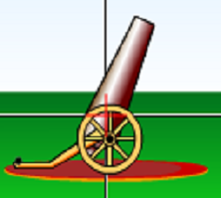
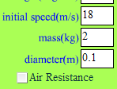
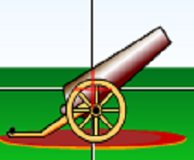
Which car will go farther?
A B
C They will go the same distance
Notes:
A is about 75 degrees B is about 35 degrees
Correct answer B

Slide 44
2. Which will be in the air longer?
A B
C same time in air
Notes:
A

Slide 45
3. Which car will go higher?
A B
C They will go the same height
Notes:
A

Slide 46
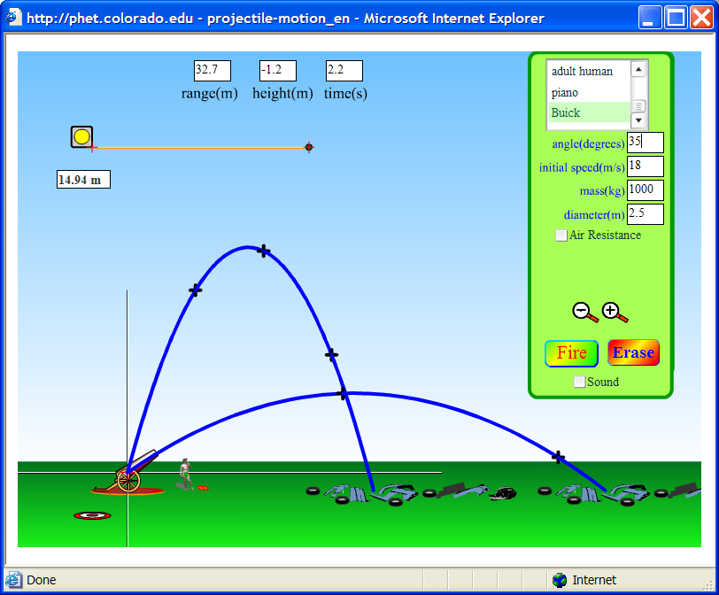
Results 1-3 (angle only variation)
Time for 75 degrees 3.6 s, 35 degrees 2.2

Slide 47
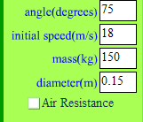

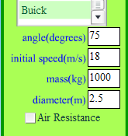
4. Which will go farther?
A B
C They will go same distance
Notes:
C

Slide 48
5. Which will go farther?
√
√
A B
C They will go same distance
Notes:
B small drag

Slide 49
6. Which will go higher?
√
√
A B
C They will go same height
Notes:
B small drag

Slide 50
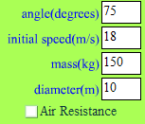
7. Which will go farther?
√
√
√
A B
C They will go same distance
Notes:
A less drag

Slide 51
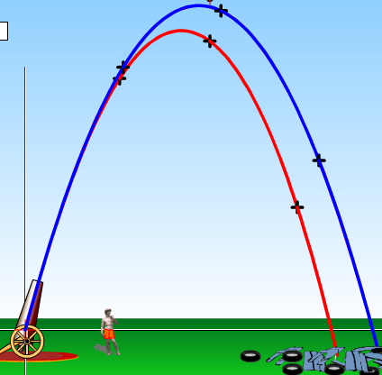
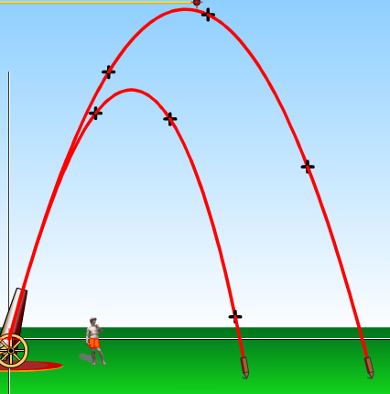
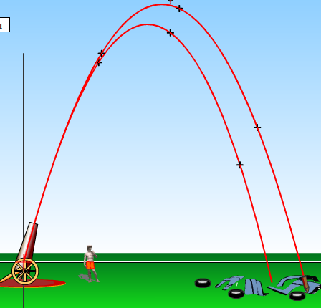
Results 4-7 Small vs large object
Red paths have air resistance
Without air resistance no difference
Buick shown
(Shell has identical paths)
Small Shell
Shell drag .05
Buick drag 1.3
Shell

Slide 52
Forces & Motion
Activity 1
Trish Loeblein phet.colorado.edu
Learning Goals: Students will be able to
Predict, qualitatively, how an external force will affect the speed and direction of an object's motion
Explain the effects with the help of a free body diagram
Explain the difference between static friction, kinetic friction and friction force. This goal is not addressed in the student directions, but is part of the post-lesson.

Slide 53


1. If the total force acts in the same direction as the crate is sliding, the crate
Crate was moving to the right
Then, the guy pushed the crate
slows down
speeds up
remains at same speed
slows down, changes direction and then speeds up going the other way
remains at same speed, but changes direction
Notes:
B

Slide 54
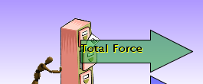

2. If the total force acts in the opposite direction as the cabinet is sliding, the cabinet would
Cabinet was moving to the left
Then, the guy pushed the cabinet
slow down
speed up
remain at same speed
slow down, change direction and then speed up going the other way
remain at same speed, but change direction
Notes:
A or D depending on how long the force is applied . This makes for a great class discussion

Slide 55
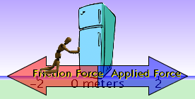

3. If there is zero total force acting on on the refrigerator, the refrigerator would
Refrigerator was moving to the right
Then, the guy pushed the refrigerator
slow down
speed up
remain at same speed
slow down, change direction and then speed up going the other way
remain at same speed, but change direction
Notes:
C

Slide 56
Forces & Motion
Activity 2
Trish Loeblein phet.colorado.edu
Learning Goals:
Students will be able to:
Use free body diagrams to draw position, velocity, acceleration and force graphs and vice versa
Explain how the graphs relate to one another.
Given a scenario or a graph, sketch all four graphs

Slide 57

1. A car is traveling along a road. Its acceleration is recorded as a function of time.
acceleration
time
Notes:
Have the students draw this

Slide 58
Which Total force-time graph would best match the scenario?
A
B
C
force
force
force
time
time
time
Notes:
C, force and acceleration match shapes because F=MA

Slide 59
2. A cabinet is speeding up as it slides right across the room. Which of the following is a possible free body diagram?
A B C
Notes:
B because net force is to the right

Slide 60
3. A car is traveling along a road. Its velocity is recorded as a function of time.
Notes:
Have the students copy this, the numbers are not important, just note that velocity is positive the entire time

Slide 61
3. Which would be the
Total force-time graph?
A
B
C
force
force
force
time
time
time
Notes:
A matches the necessary forces

Slide 62
4. A car is moving towards the right. Then a force is applied and the free body diagram looks like this
Force diagram
Draw what you think the position-time graph would look like.
Notes:
Answer choices are on next slide

Slide 63
4. Which position-time graph best matches your idea?
Notes:
D going forward slowing

Slide 64
Ramp- Force and Motion
Activity 1
If you want to make questions like I have where only one variable changes and you see what changes on the diagram: Play with the sim until you get a diagram you like. (you can go pass the spot) Pause the sim. Use the vertical bar to go back to a spot that you liked, then you can change variables (hit enter to make the change take place) and the changes will show on the diagram without having to run the sim.
Trish Loeblein phet.colorado.edu

Slide 65
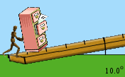
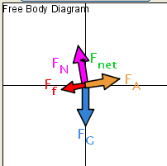
1. If the free body diagram for Betty pushing her file cabinet is:
What will happen?
The cabinet will slide down
Betty will push it up the ramp
The cabinet won’t move
Notes:
B

Slide 66
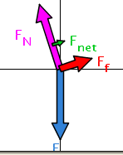
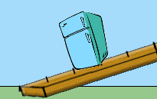

2. If this is the free body diagram for the fridge, what could be happening?
Someone is pushing it up the ramp
It is sliding down the ramp going faster
It is sliding down the ramp going slower
It is sitting still
Notes:
C (It is not D because the net force is non-zero)

Slide 67

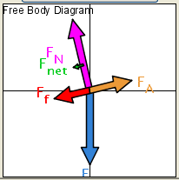

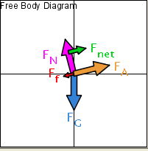
3. One of these diagrams is for a fridge (175 kg) and the other is for a file cabinet (100 kg). If all the conditions are the same, which is the fridge?
A
B
C no way to tell
Notes:
A fridge has more mass so its vectors (weight, friction and normal force are larger) the applied force (the guy pushing) is the same.

Slide 68

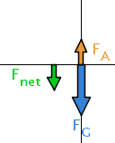
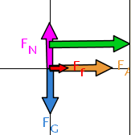
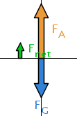
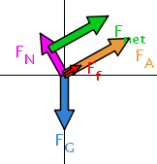

4. Which diagram could show a box of books being lifted straight up?
A
B
C
D
E no way to tell
Notes:
B (not A because the net force is downward)

Slide 69


5. Which would require less pushing force?
A
B
C no way to tell
Notes:
C The normal force and therefore the friction are higher on the 10° ramp, but there is a lower the component of the weight parallel to the ramp. So we would need to know more about the friction coefficient

Slide 70
6.It could be easier to push on the 20º ramp, because
The friction force is less
The cabinet weighs less
It is easier to plant your feet
Notes:
A (the normal force is decreased causing friction force to decrease)

Slide 71
Maze Game
Activity1
Learning Goals: Students will be able to
• Maneuver through the maze controlling position, velocity, or acceleration.
In activity, but not covered in clicker questions:
• Explain game strategies using physics principles.
Trish Loeblein phet.colorado.edu

Slide 72




1. Which one best shows where the red ball would be?
A
B
C
Notes:
B

Slide 73


2. Which best describes how the red ball will move?
Up the page
Down the page
Toward the Finish
Away from the Finish
No way to predict
Notes:
D

Slide 74

3. Which best describes how the red ball will move?
Up the page
Down the page
Toward the Finish
Away from the Finish
No way to predict
Notes:
E

Slide 75


4. If you made the ball up down the page with this velocity vector, and the changed the acceleration to this vector, what would the ball do?
Change direction and go down the page immediately
Go up the page faster
Go up the page slower
Notes:
If you use the sim, when you change to acceleration the ball quits moving and has a zero velocity. I plan to tell my students to imagine that the ball continues with the velocity and then they get to make it accelerate.
C

Slide 76
Energy Skate Park activities 1-4
I have written a series of activities and here are the learning goals for all four. Each activity can be downloaded from the Teaching Ideas section of the PhET website.
Activity 1: Introduction to Conservation of Mechanical Energy
• Explain the Conservation of Mechanical Energy concept using kinetic and gravitational potential energy.
• Design a skate park using the concept of Mechanical energy
Activity 2: Relating Graphs, Position and Speed (no time graphs)
• Describe Energy -Position, -Bar, and -Pie Charts from position or selected speeds. My thoughts about “selected” are zero, maximum, ½ max, etc
1. Explain how changing the Skater affects the situations above. The simulation treats all the objects the same (the same contact area and center of mass is one the track), so changing the type only changes the mass.
2. Explain how changing the surface friction affects the situations above.
• Predict position or estimate of speed from Energy -Position, -Bar, and -Pie Charts
• Look at the position of an object and use the Energy -Position, -Bar, and -Pie charts to predict direction of travel or change in speed. By “change in speed” I mean increasing or decreasing if for example the graph shows increasing PE, decreasing KE etc.
Activity 3: Calculating Speed and Height (no time graphs)
Students will be able to
• Calculate speed or height from information about a different position.
• Describe how different gravity fields effect the predictions.
• Describe how changing the PE reference effects the predictions. I decided to leave this goal out of the students’ directions and either discuss it with the class or omit it.
Activity 4: Calculations with Conservation of Mechanical Energy using time graphs
Students will be able to use Energy-Time graphs to… at a given time.
• Estimate a location for the Skater on a track.
• Calculate the speed or height of the Skater
• Predict energy distribution for tracks with and without friction.
Trish Loeblein phet.colorado.edu

Slide 77

1. Do you think the Skater will make it over the first hump?
(No friction on the track)
No, because his potential energy will be converted to thermal energy
No, because he doesn’t have enough potential energy
Yes, because all of his potential energy will be converted to kinetic energy
Yes, because some of his energy will be potential and some kinetic
Notes:
B

Slide 78
2. Do you think the Skater will make it over the first hump?
(lots of track friction)
No, because his potential energy will be converted to thermal energy
No, because he doesn’t have enough potential energy
Yes, because all of his potential energy will be converted to kinetic energy
Yes, because some of his energy will be potential and some kinetic
Notes:
B (A– makes for a good discussion)

Slide 79

3. Do you think the Skater will make it over the first hump?
(No friction on the track)
No, because his potential energy will be converted to thermal energy
No, because he doesn’t have enough potential energy
Yes, because all of his potential energy will be converted to kinetic energy
Yes, because some of his energy will be potential and some kinetic
Notes:
D

Slide 80
4. Do you think the Skater will make it over the first hump?
(lots of track friction)
No, because his potential energy will be converted to thermal energy
Yes, if not too much energy is converted to thermal
Yes, because all of his potential energy will be converted to kinetic energy
Yes, because some of his energy will be potential and some kinetic
Notes:
B

Slide 81

5. In the next moment, the KE piece of the pie gets larger, then
The Skater is going up hill (left)
The Skater is going down hill (right)
There is no way to tell
Notes:
B.

Slide 82
6. In the next moment, the KE piece of the pie gets larger, then
The PE part stays the same
The PE part gets larger too
The PE part gets smaller
There is no way to tell
Notes:
C

Slide 83
7. In the next moment, the KE piece of the pie gets larger, then
The Skater will be going faster
The Skater will be going slower
There is no way to tell
Notes:
A

Slide 84


1. The dotted line on the chart shows the energy of the Skater, where could she be on the track?
A
B
C
D
E
Notes:
C
The point E is Zero PE
The track is saved, but you have to change the skater to the girl. It is the default track, but I used the pause to place her at the very top of the track and moved the track so that she reaches zero PE (nearly)

Slide 85

2. The bar graph shows the energy of the Skater, where could she be on the track?
A
B
C
D
E
Notes:
D

Slide 86

3. The pie graph shows the energy of the Skater, where could she be on the track?
KE
A
B
C
D
PE
E
Notes:
B

Slide 87





4. If the ball is at point 4, which chart could represent the ball’s energy?
PE
KE
A.
B.
C.
D.
1
3
4
2
Notes:
The track is saved, but you have to select the ball and give it maximum mass to see the pie well. I used the loop track with the ball skater and made it more massive. The answer is C
A is at 1 or 3
B is at the lowest point on the track

Slide 88
5. If a heavier ball is at point 4, how would the pie chart change?
KE
No changes
The pie would be larger
The PE part would be larger
The KE part would be larger
PE
1
3
4
2
Notes:
B
Change the ball’s mass to show this

Slide 89


6. As the ball rolls from point 4, the KE bar gets taller. Which way is the ball rolling?
1
3
4
2
Up
Down
not enough info
At 4 Next step
Notes:
You will need to Zoom out on the bar graph window to see the top of the bars

Slide 90

7. The Energy chart of a boy skating looks like this
How would you describe his speed?
He is at his maximum speed
He is stopped
He is going his average speed
He is going slow
He is going fast
Notes:
A

Slide 91

8. The Energy chart of a boy skating looks like this
How would you describe his speed?
He is at his maximum speed
He is stopped
He is going his average speed
He is going slow
He is going fast
Notes:
C
Have the students predict by drawing the charts for B, D and E then show the next slide

Slide 92



9. Select a letter for each: stopped, slow and fast
A
B
C
Notes:
A slow
B stopped
C fast

Slide 93

10. Sketch this energy position graph. Label where the 5 spots, A-E, could be
Energy vs Position
PE
KE
He is going his maximum speed
He is stopped
He is going his average speed
He is going slow
He is going fast

Slide 94
Energy Skate Park 4
Learning Goals:
Students will be able to use Energy-Time graphs to… at a given time.
• Estimate a location for the Skater on a track.
Calculate the speed or height of the Skater Friction and frictionless.
Predict energy distribution for tracks with and without friction.
By Trish Loeblein updated July 2008
The Friction concepts are not addressed in these clicker questions. Some screen images are included, but it would be better to have the sim running. I have used tracks that are the default or under Track menu for easy reproduction.
phet.colorado.edu

Slide 95



1. What will the speed of the 75kg Skater be at 2 seconds?
Total =2918 J
KE=509 J
PE=2408 J
PE = 0 at dotted line
A. 14m/s B. 8.8m/s C. 8.0m/s D. 3.7m/s
Notes:
D
This is the default track with the PE line moved up to the track

Slide 96
Comments for question 1: This is the default track with the PE line moved up to the track
KE= 1/2mv²
509=1/2*75* v²
14 is no sqrt
8 uses PE
8.8 uses Total E

Slide 97


2. At what height is the 60kg Skater at 2 seconds?
Total =3829 J
KE=2429 J
PE=1365 J
A. 6.5m B. 4.2m C. 2.3m D. 1.9m
Notes:
B
I used the Double well roller coaster track with the Skater changed to the girl and I moved the PE line to the bottom of the first well. Then I started from the “Return Skater” position

Slide 98
Comments for question 2: I used the Double well roller coaster track with the Skater changed to the girl and I moved the PE line to the bottom of the first well. Then I started from the “Return Skater” position.
Comments about #3. I would show the slide, have the students make a drawing and then show the options on the next slide.
6.5 uses Total E, 4.2 uses KE, 1.9 uses mass of 75,

Slide 99

3. Draw what you think the energy graph look like at 10 seconds.
Notes:
I used the double well roller coaster again with a ball at 18 kg for #3 and #4

Slide 100



3. The energy graph at 10 s:
A
B
C
10
Notes:
B

Slide 101

Comments and answer to 3: I used the double well roller coaster again with a ball at 18 kg for #3 and #4

Slide 102


4. What might the ball be doing at 5 seconds?
Going left to right at the lower dip
Going right to left at the lower dip
Going left to right at the higher dip
Going right to left at the higher dip
PE KE
Notes:
B

Slide 103




Answer to 4

Slide 104
Masses and Springs:
Conservation of Energy
Activity
Learning Goals: Students will be able to explain the Conservation of Mechanical Energy concept using kinetic, elastic potential, and gravitational potential energy.
Trish Loeblein phet.colorado.edu

Slide 105
1. The main difference between kinetic energy, KE, and gravitational potential energy, PE_{g,} is that
KE depends on position and PE_{g} depends on motion
KE depends on motion and PE_{g} depends on position.
Although both energies depend on motion, only KE depends on position
Although both energies depend position, only PE_{g} depends on motion
Notes:
B

Slide 106
2. Joe raised a box above the ground. If he lifts the same box twice as high, it has
four times the potential energy
twice the potential energy
there is no change in potential energy.
2h
h
Notes:
B

Slide 107
3. As any object free falls, the gravitational potential energy
vanishes
is immediately converted to kinetic energy
is converted into kinetic energy gradually until it reaches the ground
Notes:
C

Slide 108
A spring is hanging from a fixed wire as in the first picture on the left. Then a mass is hung on the spring and allowed to oscillate freely (with no friction present). Answers A-D show different positions of the mass as it was oscillating.
Spring with no mass attached
A.
B. Mass at maximum height
C. Mass at minimum height
D.
5. Where does the spring have maximum elastic potential energy?
Notes:
The dotted lines are on the drawing to help you see the change in position relative to the spring with no mass.
Say “ you may need more than one answer. The answers are B and C

Slide 109
6. Where is the gravitational potential energy the least?
A spring is hanging from a fixed wire as in the first picture on the left. Then a mass is hung on the spring and allowed to oscillate freely (with no friction present). Answers A-D show different positions of the mass as it was oscillating.
Spring with no mass attached
A.
B. Mass at maximum height
C. Mass at minimum height
D.
Notes:
C

Slide 110
7. Where is the kinetic energy zero?
A spring is hanging from a fixed wire as in the first picture on the left. Then a mass is hung on the spring and allowed to oscillate freely (with no friction present). Answers A-D show different positions of the mass as it was oscillating.
Spring with no mass attached
A.
B. Mass at maximum height
C. Mass at minimum height
D.
Notes:
B and C

Slide 111
8. Where is the elastic potential energy zero?
A spring is hanging from a fixed wire as in the first picture on the left. Then a mass is hung on the spring and allowed to oscillate freely (with no friction present). Answers A-D show different positions of the mass as it was oscillating.
Spring with no mass attached
A.
B. Mass at maximum height
C. Mass at minimum height
D.

Slide 112
Pendulum Lab
Activity 1
Learning Goals: Students will be able to:
Design experiments to describe how variables affect the motion of a pendulum.
Use a photogate timer to determine quantitatively how the period of a pendulum depends on the variables you described.
I plan to have the sim open to demonstrate the answers, but I have included the results from the photogate timer just for precise evidence.
Trish Loeblein updated 7/20/2008
phet.colorado.edu

Slide 113


1. Which one swings faster?
They go the same speed
1 is faster
2 is faster
Notes:
Shorter one is faster
Since no friction, both go back to initial angle

Slide 114


Answer to 1

Slide 115
2.What is true about the maximum angle as they swing left?
They have the same max angle
1 swings to a greater angle
2 swings to a greater angle

Slide 116


3. What will be the differences in the swinging patterns?
There are no differences
1 swings higher; stops last
1 swings higher; stops first
1 swings lower; stops first
1 swings lower; stops last
Notes:
D Smaller mass swings less high and stops first.

Slide 117


4. Which one will stop first?
They stop at the same time
1 stops first
2 stops first
Notes:
They stop at the same time because same mass, length doesn’t matter

Slide 118


5. Which has the shortest period?
They have equal periods
1 has a shorter period
2 has a shorter period
Notes:
Lower angle shorter period

Slide 119


Answer to 5

Slide 120
Gravity and Orbits & Gravity Lab
Activity
Trish Loeblein 2/20/11
Learning Goals- Students will be able to
Draw motion of planets, moons and satellites.
Draw diagrams to show how gravity is the force that controls the motion of our solar system.
Identify the variables that affect the strength of the gravity
Predict how motion would change if gravity was stronger or weaker.
phet.colorado.edu

Slide 121




If our sun were twice as massive, how might the earth movement change?
The earth would definitely crash into the sun
B. The path would be smaller
C. The path would not change
Notes:
B. In the cartoon mode, the earth crashes into the sun, but in reality, the path is just reduced in size.

Slide 122




Which vector representation would show the moon between the earth and the sun? (black arrow Total Gravity Force moon)
B.
C.
Notes:
Most students chose A because the vector appears to be the smallest, which would make sense if you think of vector addition of the gravity of the earth and gravity and sun although the moon vector is not to scale compared to the earth sun vector.

Slide 123



Use the simulation to show the path of the moon and the resulting vectors.
Remember that the placement of vectors in space is arbitrary. The point (0,0) can be anywhere.
Notes:
Review that the placement of vectors in space is arbitrary.

Slide 124
Ladybug Motion 2D
Activity
Learning Goals: Students will be able to draw motion vectors (position, velocity, or acceleration) for an object is moving while turning.
Open Ladybug Motion 2D and Ladybug Revolution before starting the questions.
Trish Loeblein July 2009
phet.colorado.edu

Slide 125


1. What could the position and velocity vectors look like?
A.
B.
C.
D.
Notes:
Remind the students that the flower represents the (0,0) location.
D is correct

Slide 126



You could run the sim and discuss that in this situation the bug is traveling clockwise as opposed to counter clockwise in the sim. The velocity vector could be a different length depending on speed, but that the direction is correct.

Slide 127
2. What could the acceleration and velocity vectors look like?
A.
B.
C.
D.
Notes:
C is correct

Slide 128

You could run the sim and discuss that in this situation the bug is traveling clockwise and that speed affects both velocity and acceleration vector length, but that the direction is correct.

Slide 129

3. What could the position & acceleration vectors look like?
A.
B.
C.
D.
Notes:
B is correct

Slide 130


The acceleration would not be radial or the path would be circular. This is very difficult to see in the sim.

Slide 131
4. If you had two bugs moving in circles like this, what could the velocity vectors at point X vs point Y look like?
 | X | Y
A
B
C
D | Any of the above
E | None of the above are possible
X
Y
Notes:
D is correct, see next slide for possible discussion

Slide 132

IF they were connected with a bar so they had to go around together, it would be like in Ladybug Revolution, but otherwise there is no way to know the vector length relationship, but the vectors would be parallel. I am thinking that the bugs might arrive at X and Y at different times.
X
Y

Slide 133
Lady Bug Revolution
Activity
Learning Goals Students will be able to:
1. Explain the kinematics’ variables for rotational motion by describing the motion of a bug on a turntable. The variables are:
    o Angular displacement, speed, and acceleration
    o Arc length
    o Tangential speed
    o Centripetal and tangential acceleration
2. Describe how the bug’s position on the turntable affects these variables.
Trish Loeblein phet.colorado.edu

Slide 134
Ladybug Revolution activity directions:
In this activity, you must include values that you measure and show sample calculations to support your answers to the questions. Include examples that use both bugs in different locations.

Slide 135
Sample calculations include:
Equation: PE=mgh
Substitution: PE = .50*9.81* 2
Answer with units: 9.81 J

Slide 136



1. A bug is spinning on a platform with constant speed, what was the direction of acceleration at the blue point?
B
A
C
Beginning of test
End of test
D
E none of these
Velocity is the green vector

Slide 137



Answer to previous slide
Beginning of test
End of test
A: acceleration vector always points radially for constant speed

Slide 138

2. A bug is on a platform spinning clockwise & speeding up. Which best shows the bug’s acceleration direction at this spot?
C
B
A
E
D
Notes:
B

Slide 139


Answer to previous slide
B: If the acceleration is constant and increasing, the vector will be not radial, but off to the same side of the radius as the velocity vector.

Slide 140

CRT rot 1 answer explanation 1
Notes:
Lady bug not really v=0, just rounded.

Slide 141
Understanding KMT using Gas Properties and States of Matter
Activity
Trish Loeblein phet.colorado.edu
Learning Goals: Students will be able to describe matter in terms of particle motion. The description should include
Diagrams to support the description.
How the particle mass and temperature affect the image.
How the size and speed of gas particles relate to everyday objects
What are the differences and similarities between solid, liquid and gas particle motion

Slide 142


If you have a bottle with Helium & Nitrogen at room temperature, how do the speed of the particles compare?
All have same speed
The average speeds are the same
Helium particles have greater average speed
Nitrogen particles have greater average speed
Notes:
Use Gas Properties to show C is correct

Slide 143


Light and heavy gas at same temperature 300K
Speed of each particle varies!!

Slide 144

What happens if you add energy using the heater?
All atoms speed up
All atoms speed up about the same
The lighter ones speed up more
The heavier ones speed up more
Notes:
A is the best answer, b is not true, the other options depend on how you define “more”, see next slide

Slide 145






answer
Notes:
687/411=1.67 1516/1172= 1.3 So the light species doesn’t change by the same factor
687-411= 276 1516-1172= 344 nor does it just add.

Slide 146



Which is most likely oxygen gas?
A B C
Notes:
C discussion how do you know?

Slide 147



Which is most likely liquid water?
A B C
Notes:
discussion how do you know? A I am not sure that my students remember that water is less dense in solid form, but this would be a good time to remind them that ice floats.

Slide 148
How many water molecules are in a raindrop(.5 cm diameter). The molecules are about .1nm
If we just look at how many are across .05m/.1E-9m = 5E7 or 50 million.

Slide 149
To show vibration
http://chemeddl.org/collections/molecules/index.php
Check Spin Molecule to see 3D rotation
Show vibration under Normal modes of vibration (toggle down to see bond length changing)

Slide 150
KMT summary:
Matter is made up of particles having negligible mass are in constant random motion (vibrate, rotate, translate)
The particles are separated by great distances
The particles collide perfectly elastically (there are no forces acting except during the collision)
The temperature of a substance is related to the molecular velocity.

Slide 151
Waves on a String
Activity
Trish Loeblein phet.colorado.edu
Learning Goals: Students will be able to discuss wave properties using common vocabulary and they will be able to predict the behavior of waves through varying medium and at reflective endpoints.

Slide 152

A
Notes:
Say this: The figure below shows a rope on a tile floor with a knot at point A. Someone has shaken the end sideways to make a pulse. You are looking down and taking a movie of the motion. Below is one freeze frame of the movie.
Have a rope to demonstrate.

Slide 153
A
1. If you advance the movie one frame, the knot at point A would be
in the same place
higher
lower
to the right
to the left
Notes:
B

Slide 154
A
2. If the person generates a new pulse like the first but more quickly, the pulse would be
same size
wider
narrower
Notes:
C

Slide 155
A
3. If the person generates another pulse like the first but he moves his hand further, the pulse would be
same size
taller
shorter

Slide 156
A
4. If the person generates another pulse like the first but the rope is tightened, the pulse will move
at the same rate
faster
slower
Notes:
B

Slide 157

A
Notes:
Now the person moves his hand back and forth several times to produce several waves. You freeze the movie and get this snapshot.

Slide 158
A
5. If you advance the movie one frame, the knot at point A would be
in the same place
higher
lower
to the right
to the left
Notes:
C

Slide 159
A
6. If you advance the movie one frame, the pattern of the waves will be _________relative to the hand.
  in the same place
  shifted right
  shifted left
  shifted up
  shifted down
Notes:
B

Slide 160
A
7. If the person starts over and moves his hand more quickly, the peaks of the waves will be
the same distance apart
further apart
closer together
Notes:
C

Slide 161
If you lower the frequency of a wave in a string you will
lower its speed.
increase its wavelength.
lower its amplitude.
shorten its period.

Slide 162
The pulse on the left is moving right, the pulse on the right is moving left. What do you see when the pulses overlap?

Slide 163
Rest of question

Slide 164
B

Slide 165
After interacting
Adapted from CQ from Pollock University of Colorado

Slide 166

A periodic wave is made to travel from a thick string into a thin string held at the same tension.
As the wave passes the join the wave's
A. frequency increases.
B. frequency decreases.
C. wavelength increases.
D. wavelength decreases.
Wave refraction

Slide 167
Fourier: Making Waves
Activity
1 Wave Representation Learning Goals:
Students will be able to think about waves as a function of time, space or space-time and explain why waves might be represented in these different ways.
2 Superposition of Waves Learning Goals:
Students will be able to:
Define harmonic, determine the relationship between the harmonics,
Explain the relationship between harmonics and the corresponding wave function.
Predict what happens when more than one wave is present.
Trish Loeblein phet.colorado.edu
Notes:
One idea would be to review Waves on a String questions

Slide 168
1. If these two waves were moving through water at the same time, what would the water look like?
Wave 1
A
x
B
Wave 2
x
C
D
Notes:
D

Slide 169
Sound
Activity
I used questions 1-8 with the sound activity and the rest on the next day.
Learning Goals: Students will be able to
Explain how different sounds are modeled, described, and produced.
Design ways to determine the speed, frequency, period and wavelength of a sound wave model.
Trish Loeblein phet.colorado.edu

Slide 170


1. A student started the speaker by clicking on the stopwatch. How many sound waves are there is this trial?
3
5
4
8
Notes:
C 4 although you may get some argument about more exact numbers. I used 4 for all the following questions about this trial.
A 3 because there are 3 dark areas
B lots of students confuse the ruler reading with other things
D I count 8 light and dark areas total

Slide 171
2. What is the speed of the sound waves shown here?
300 m/s
330 m/s
0.0030 m/s
66 m/s
Notes:
B is correct 5/.0151=331
A is the number that our text uses for speed of sound in all problems
C is .0151/5
D is 1/.0151

Slide 172
3. What is the frequency of the sound waves shown here?
0.0037 hz
66 hz
260 hz
300 hz
330 hz
Notes:
C is correct 4/.0151=260 The sim actually said 228 but I count 4 waves
A is .0151/4 waves
B is 1/.0151
D is the number that our text uses for speed of sound in all problems
E 330 is speed

Slide 173
4. What is the period of the sound waves shown here?
0.0151 s
0.0037 s
260 s
300 s
330 s
Notes:
B is correct 1/f or is .0151/4 waves
A is stop watch time
C is frequency
D is the number that our text uses for speed of sound in all problems
E 330 is speed

Slide 174
5. What is the wavelength of the sound waves shown here?
5 m
1.3 m
1 m
0.71 m
300 m
Notes:
B 5/4
A distance of first wavefront
C 5/5 incase can’t count waves
D 5/7 count dark and light areas
E is the number that our text uses for speed of sound in all problems

Slide 175

6. If your lab partner moved the frequency slider to the left so that it changed from 500 to 250 the period would be
twice as big
1/2 as big
Stays the same
1/4 times as big
Not enough information to decide
Notes:
A

Slide 176

7. If you moved the slider to the far right, doubling the amplitude, the period would be…
twice as big
1/2 as big
Stays the same
1/4 times as big
Not enough information to decide
Notes:
C they are independent

Slide 177
8. If the speaker vibrates back and forth at
200 Hz how much time passes between each time it produces a maximum in pressure?
Sound waves traveling out
0.2 seconds
0.200 seconds
0.005 seconds
0.02 seconds
e. 0.05 seconds
Notes:
c. 0.005 seconds.
Period = 1 second/ 200 cycles
= 0.005 seconds/cycle

Slide 178

9.A speaker is playing a constant note.
What happens to the sound when you
put a solid, thick glass jar over it and
pump the air out from the jar.
1 => hardly any difference
2 => hardly any difference
1=> hardly any difference
2 => much quieter
1=> noticeably quieter
2 => hardly any MORE quiet
1=> noticeably quieter
2=> much quieter still (near silence)
E) None of these/something else/??
Adapted From Pollock at CU 1240 course at University of Colorado
Notes:
D. I would show just the question before clicking to show the answers

Slide 179

10. If you could put a dust particle in front of the speaker. Which choice below shows the motion of the dust particle?
(up and down)
(steadily to the right)
(left and right)
(no motion)
(circular path)
dust
Notes:
C

Slide 180
11.The picture shows “displacement as a function of location along a string”
What is the wavelength (“λ”)?
E none of these
C
D
B
A
Remember X axis is position not time
Notes:
A

Slide 181
12.The picture shows “displacement as a function of location along a string”
What is the amplitude?
E none of these
C
D
B
A
Remember X axis is position not time
Fundamentals of waves
Notes:
C

Slide 182
13.Looking at the following waveform, what is the period? assume it repeats itself over and over
1
2
time (sec)
1 sec
2 sec
1 m/s
2 m/s
Not enough information
Notes:
B

Slide 183
14 Looking at that same wave,
what is its speed?
1
2
Time (sec)
1/2 m/s
2 m/s
5 m/s
20 m/s
Not enough information
Notes:
E.

Slide 184
CT 2.1.10
15 The wavelength, λ, is 10 m. What is the speed of this wave?
Time (sec)
1
1 m/s
just under 7 m/s
C) 10 m/s
D) 15 m/s
E) None of the above/not enough info/not sure
Notes:
D 10/(2/3)

Slide 185
16 What is the period of this wave?
t₁
t₂
t₂-t₁
t₃-t₁
None of the above
Amp
time
t₁
t₂
t₃
t₄
0
Notes:
D

Slide 186
17 Which one of the following is most likely to be impossible?
A. Transverse waves in a gas
B. Longitudinal waves in a gas
C. Transverse waves in a solid
D. Longitudinal waves in a solid
E. They all seem perfectly possible
Notes:
E

Slide 187
18. To increase the volume of a tone at 400 Hz heard by the listener, the speaker must oscillate back and forth more times each second than it does to produce the tone with lower volume.
A. True B. False
Notes:
B

Slide 188
Wave Interference Activity is a demo that uses three simulations: Waves on a String, Wave Interference, and Sound.
Trish Loeblein phet.colorado.edu
Learning Goals: Students will be able to
Predict the pattern of a reflected wave
Relate two dimensional representations of waves to three dimensional waves
Explain wave patterns from interfering waves (Apply the superposition principle to water, sound and light)
Recognize the Doppler effect and predict the change in frequency that occurs.
Notes:
There is a detailed lesson plan that uses this slide show. Not all the parts are included in the slide notes.

Slide 189





1. What will this wave look like after it reflects?
A.
B.
Fixed end
c.
D.
Notes:
C

Slide 190

2. What will this wave look like after it reflects?
A.
Loose end
B.
c.
D.
Notes:
B

Slide 191

Draw what you think this wave will look like after reflecting off the barrier.

Slide 192



3. Which one is the reflection pattern?
Wave pulse from speaker
A
B
Notes:
A

Slide 193
“Sound waves are three dimensional.”
Talk to your partner:
What evidence you have that supports this.
How the wave could be represented
How would reflection change?
Notes:
Make a 3D standing wave with Tygon tubing by twirling in a circular motion instead of just up and down.
Use Wave Interference: Water tab with faucet moved to middle. Use Rotate view, Show Graph and add detectors.
Sound tab in the particle mode to show one wave to represent 3d.
Show water waves in the wave tank.

Slide 194

Sketch what you think the pattern will look like
Notes:
I used the Pulse feature with Zero damping. First I set the wave characteristics, then pulsed and paused quickly. Then I reset the characteristics and sent another pulse. Quickly ,I paused again and used the Step feature for slow motion. You can cycle through the waves interactions many times by stepping.

Slide 195


Measurements
Notes:
May or may not use this slide and the next

Slide 196



Paused clips
Notes:
Optional slide

Slide 197
Resonance
Activity by Trish Loeblein and Mike Dubson
Learning Goals: Students will be able to:
Describe what resonance means for a simple system of a mass on a spring.
Identify, through experimentation, cause and effect relationships that affect natural resonance of these systems.
Give examples of real-world systems to which the understanding of resonance should be applied and explain why. (not addressed in CQ’s)
phet.colorado.edu

Slide 198

1. Which system will have the lower resonant frequency?
Mass (kg) | 2.5 | 5.0
Spring constant (N/m) | 100 | 100
A) 1 B) 2 C) Same frequency
Notes:
B because of the heavier mass. Some students may select C since the spring constants are equal. Use the sim to show the students.

Slide 199

2. Which system will have the lower resonany frequency?
Mass (kg) | 5.0 | 5.0
Spring constant (N/m) | 200 | 100
A) 1 B) 2 C) Same frequency.
Notes:
B because of the lower spring constant. Some students may select C since the masses are equal. Use the sim to show the students. 1 has 1 hz and 2 has .7hz

Slide 200

3. Which system will have the lower resonance frequency?
Mass (kg) | 3.0 | 3.0
Spring constant (N/m) | 400 | 400
Driver Amplitude (cm) | 0.5 | 1.5
A) 1 B) 2 C) Same frequency.
Notes:
C amplitude of the driver is an independent variable of frequency

Slide 201

4. Which best describes how the motion of the masses vary?
Less driver amplitude results in greater max height & faster oscillation
More driver amplitude results in greater max height & faster oscillation
Less driver amplitude results in greater max height
More driver amplitude results in greater max height
Mass (kg) | 3.0 | 3.0
Spring constant (N/m) | 400 | 400
Driver Amplitude (cm) | 0.5 | 1.5
Notes:
D amplitude of the driver is directly related to oscillation distance (A and B include another way to relate frequency; the frequency is not dependent on driver amplitude)

Slide 202




4. If the frequency f of the driver is not the same as the resonant frequency, which statement is most accurate?
The steady-state amplitude is ..
smallest at the highest driver f.
largest at the highest driver f.
is largest at driver f nearest the resonant frequency.
is independent of driver f.
Notes:
C

Slide 203
Geometric Optics
Activity
Plane mirrors only
Learning Goals: Students will be able to explain
How a converging lens makes images.
How changing the lens effects where the image appears and how it looks
Trish Loeblein phet.colorado.edu

Slide 204

Where will the image appear?
On the left, at the zero mark.
On the right, at the 150 mark.
On the right, at the 200 mark.
On the right, at the 300 mark.
Notes:
C
1/f=1/d(image) + 1/d(object) 1/50= 1/d+1/100 d=100 positive sign indicates right side

Slide 205
How will the image look?
Same size
Smaller
Larger
Same size
Smaller
Notes:
D real images are inverted
M=d(image)/d(object) M=100/100=1

Slide 206

Simulation results

Slide 207


Where will the image appear if the lens were concave?
On the left, at the zero mark.
On the left, at the 67 mark.
On the left, at the 33 mark.
On the right, at the 200 mark.
Notes:
This cannot be demonstrated with the sim B
1/f=1/d(image) + 1/d(object) 1/-50= 1/d+1/100
d=-33 negative sign indicates left side

Slide 208
How will the image look?
Same size
Smaller
Larger
Same size
Smaller
Notes:
This cannot be demonstrated with the sim B
Vitual images are upright
M=d(image)/d(object) M=33/100=.33

Slide 209
If the lens is made fatter in the middle, how will the image change?
Larger, further away
Smaller, further away
Larger, closer
Smaller, closer
Notes:
D.

Slide 210

Answer: closer and smaller

Slide 211
If you replace the lens with a mirror, the image will be
Same size
Smaller
Larger
Same size
Smaller
Notes:
A

Slide 212
If you move the arrow towards the mirror, the image will be
Same size
Smaller
Larger
Same size
Smaller
Notes:
A plane mirrors do not change magnification

Slide 213

If the lens had a lower index of refraction, the image be
Same size
Smaller
Larger
Same size
Smaller
Notes:
C however, if you make the index, too small you may get a virtual image because object will be between lens and focal point.

Slide 214


answer
Notes:
It would be nice to show how changing the index can make a virtual image.

Slide 215
Faraday’s Electromagnet Lab by Trish Loeblein May 10, 2010
Learning Goals Activity 1: Students will be able to
Predict the direction of the magnet field for different locations around a bar magnet and electromagnet.
Compare and contrast bar magnets and electromagnets
Identify the characteristics of electromagnets that are variable and what effects each variable has on the magnetic field’s strength and direction.
Relate magnetic field strength to distance quantitatively and qualitatively
Compare and contrast the fields of gravity and magnets qualitatively
Learning Goals Activity 2: Students will be able to:
Identify equipment and conditions that produce induction
Compare and contrast how both a light bulb and voltmeter can be used to show characteristics of the induced current
Predict how the current will change when the conditions are varied.
phet.colorado.edu

Slide 216





1.Which compass shows the correct direction of the magnet field at point A?
A
Notes:
D

Slide 217


2.Which compass shows the correct direction of the magnet field at point A?
A
Notes:
A

Slide 218
3.Which compass shows the correct direction of the magnet field at point A?
A
Notes:
A

Slide 219


4.What will happen if you switch the battery so that the positive end is on the right?
The electrons will go faster
The electrons will go the slower
The compass will switch directions
The electrons will go the other direction
Two of the above.
Notes:
E (C and D) show this with the sim

Slide 220


5.What would you expect the light to do if you change the coils from 2 to 3 and you move the magnet the same speed?
Show the same brightness
Show less brightness
Show more brightness
Notes:
C

Slide 221



6.Which would be a more strong magnet?
A
B
They would be the same
Not enough information to decide
B
A
Notes:
A larger diameter provides more field. This is easily demonstrated on the generator tab

Slide 222


7.Which would be a more strong magnet?
A
B
They would be the same
Not enough information to decide
A
B
Notes:
B more coils provides more field. This is easily demonstrated on the generator tab

Slide 223
Faraday Law Flash Lab
Activity
Trish Loeblein phet.colorado.edu
Learning Goals:
Students will be able to:
Identify equipment and conditions that produce induction
Compare and contrast how both a light bulb and voltmeter can be used to show characteristics of the induced current
Predict how the current will change when the conditions are varied.

Slide 224

Magnet
Two bar magnets are brought near each other as shown. The magnets...
A) attract
B) repel
C) exert no net force on each other.
Notes:
B

Slide 225
Electric Field Hockey and Charges and Fields
Activity
Learning Goals: Students will be able to
Determine the variables that affect how charged bodies interact
Predict how charged bodies will interact
Describe the strength and direction of the electric field around a charged body.
Use free-body diagrams and vector addition to help explain the interactions.
All but the last 2 questions are adapted from Perkins’ homework for a PHYS1010 lecture on electric charges from CU Boulder. The assignment can be downloaded from the PhET Teaching Ideas pages.
Trish Loeblein phet.colorado.edu

Slide 226


All of the pucks feel a force to the right.
A. True B. False
Original question from Perkins University of Colorado
Notes:
All but the last 2 questions are adapted from Perkins’ homework for a PHYS1010 lecture on electric charges from CU Boulder. The assignment can be downloaded from the PhET Teaching Ideas pages.
A true

Slide 227

The puck in C feels a greater force to the right than the puck in D.
A. True B. False
Original question from Perkins University of Colorado
Notes:
B false The only difference between C) and D) is two extra minus charges to the right of the puck. Since the puck has a minus charge, it will be repelled from these extra charges, and will feel less force to the right in C than in D.

Slide 228



The puck in E feels a force to the right that is four times greater than that felt by the puck in B.
A. True B. False
Original question from Perkins University of Colorado
Notes:
A true Both E) and B) have the same charges nailed down and on the puck. But in E) the nailed-down charges are half as far away as in B). Since the force is proportional to 1/r^2, this means that the force will be (1/2)^2=1/4 times as large in B as in E. (this is exactly the same problem as #1 part d ii).

Slide 229

The net force on the puck in A is zero.
A. True B. False
Original question from Perkins University of Colorado
Notes:
B The negatively charged puck is repelled from the minus charges to its left, making for a force to the right, and attracted to the plus charges on its right, making for another force to the right. Two rightward forces add to give a rightward net force, not zero.

Slide 230
For which of these choices is puck most likely not to move?
A
-
-
-
-
-
-
B
-
-
-
-
-
-
C
-
-
-
-
-
-
Original question from Perkins University of Colorado
Notes:
A

Slide 231
Answer A Look at forces from each charge and add them up
A
Color-code
force from each
charge.
-
-
-
-
-
-
Original question from Perkins University of Colorado

Slide 232
If we put bunch of electrons in a box. They will
a. clump together.
b. spread out uniformly across box.
c. make a layer on walls.
d. do something else.
Original question from Perkins University of Colorado
Notes:
b

Slide 233
Which one would help explain why a charged balloon sticks to a wall.
Original question from Perkins University of Colorado
Notes:
C A negatively charged balloon sticks to the wall because the wall's negative charges are farther away than the wall's positive charges, making for a net attraction.

Slide 234

Which arrow best represents the direction of acceleration of the puck as it passes by the wall ?
+
+
+
Original question from Perkins University of Colorado
Notes:
C -- The positively charged puck is repelled from both of the positive charges near it in the picture. The charge to its left will push the puck to the right and up while the charge on its right will push the charge left and up. Since the puck's position is halfway between the two charges horizontally and a little higher than both vertically, the right- and leftward forces on the puck will cancel each other, while the two upward forces will reinforce each other.

Slide 235
Balloons and Static Electricity and John Travoltage
Activity link
Learning Goals: Students will be able to describe and draw models for common static electricity concepts. (transfer of charge, induction, attraction, repulsion, and grounding)
Trish Loeblein phet.colorado.edu

Slide 236

1. When the balloon is rubbed on the sweater, what might happen?

Slide 237



1. When the balloon is rubbed on the sweater, what might happen?
A. Some positive charges in the sweater will move onto the balloon
B. Some negative charges in the sweater will move onto the balloon
Notes:
B Only the electrons can transfer. The positive charges are protons which cannot move.

Slide 238


2. What do you think will happen when the balloon is moved closer to the wall?
Negatively charged balloon
Neutral wall

Slide 239



2. What do you think will happen when the balloon is moved closer to the wall?
Some positive charges in the wall will move towards the balloon
Some negative charges in the wall will move towards the balloon
Some positive charges in the wall will go onto the balloon
Some negative charges on the balloon will go to the wall
Notes:
A induction causes the electrons to move away. The positive charges are protons which cannot move.

Slide 240
3. What do you think the balloons will do?
Negatively charged balloon
Negatively charged balloon

Slide 241
3. What do you think the balloons will do?
The balloons will move towards each other
B. The balloons will move away from each other
C. The balloons will not move.
Notes:
B. The negative charged bodies will repel one another.

Slide 242

4. What might happen to the charge on the man when he touches the door knob?

Slide 243


4. What might happen to the charge on the man when he touches the door knob?
Most electrons will go into the knob and down to the earth.
B. Some electrons will go from the earth through the knob and into the man.
Notes:
A. Some electrons will go into the earth

Slide 244
Density by Trish Loeblein used with Density Activity
Learning Goals:
Students will be able to use macroscopic evidence to:
Measure the volume of an object by observing the amount of fluid it displaces or can displace.
Provide evidence and reasoning for how objects of similar:
  mass can have differing volume
  volume can have differing mass.
Identify the unknown materials by calculating density using displacement of fluid techniques and reference tables provided in the simulation.
Notes:
I used these after the activity.

Slide 245


1. You put in a pool with 100 L of water. Then you drop an aluminum block in and the volume rises to 105 L. What is the volume of the block?
5L
105 L
Depends on block shape
Not enough information
Notes:
A.

Slide 246


2. You put in a pool with 100 L of water. Then you drop an wood block in and the volume rises to 102 L. What is the volume of the block?
5L
105 L
Depends on block shape
Not enough information
Notes:
D because it is floating

Slide 247


3. Two different blocks, both with a mass of 5 kg have different volumes. How is it possible?
One is more dense
They are made of the same material
They are made of different material
More than one of these
None of the above
Notes:
D both A and C

Slide 248


4. Two different blocks, both with a volume of 3.38L have different mass. What would be a good explanation?
A is more dense
D is more dense
A sinks
D floats
More than one of these
Notes:
A is the best answer. D is a true statement but not relevant.

Slide 249




Some information for 4
Volume changes when submersed
Mass found using scale
It is true that D floats, but it is irrelevant to question. The important thing is that A is more dense – it’s mass is greater even though volume is the same.
Notes:
Go over vocabulary “submersed”

Slide 250

5. What is the density of the block?
0.63 L/kg
1.6 L/kg
0.63 kg/L
1.6 kg/L
Notes:
D is correct Distractors: a. wrong calc 4L/6.3 kg =.63 b. wrong units C. wrong calc and units

Slide 251


6. Joe was doing a lab. He massed an object and then pushed it into some water. He recorded- 3.5 kg and 5 L. What might the object be?
A.
B.
C.
D.
E.
Notes:
B 3.5/5 = .66 kg/L close to Apple

Slide 252

7. What is the mass of the block if it has a density of 0.86?
5.0 kg
91 kg
0.15 kg
6. kg
Notes:
a

Slide 253
Balloons and Buoyancy
Activity
Learning Goals: Students will be able on a molecular level to
Explain why a rigid sphere would float or sink.
Determine what causes helium balloon to rise up or fall down in the box.
Describe the differences between the hot air balloon, rigid sphere, and helium balloon.
Explain why a hot air balloon has a heater.
Teacher note: If you are going to use the simulation to demonstrate, remember that Reset only clears the box of particles, it does not change any settings.
Trish Loeblein phet.colorado.edu

Slide 254


Would you expect the rigid sphere to float or sink?
Sink
Float
Notes:
A Sink because the density is obviously (or not, see next slide for more info) greater in the sphere.

Slide 255


The container is about 8 times larger so the density is much greater in the sphere

Slide 256

Would you expect the rigid sphere to float or sink?
Sink
Float
Notes:
A Sink because the density is still be greater in the sphere. See next slide for more info

Slide 257

The container density would be about 60/8 = 7.5 and 20/1 because the box is about 8 times larger. The more dense sphere would sink

Slide 258


What will the hydrogen balloon do?
Expand and float
Expand and sink
Stay the same size and float
Stay the same size and sink
Notes:
A Theoretically, if the balloon were “perfectly elastic”, the balloon would expand when the molecules collide with the inside until the pressure on the inside is equal to the pressure on the outside. However, in this simulation, the balloon does provide some resistance to expansion and also has some mass. Because there are very few molecules on the outside the balloon will expand, but the balloon does not “pop”. The heavier particles are more effected by gravity, so the density on the outside will be more than the density inside so it will float. The gravity is set to about the middle and if you want to show this with the sim, be prepared for the sim to run for a couple of minutes. If you have no gravity, the behavior is different.

Slide 259


Slide 260


What will the hydrogen balloon do?
Expand and float
Expand and sink
Stay the same size and float
Stay the same size and sink
Notes:
B The balloon will expand again, but since the molecules are the same mass and there are many more on the outside, it will not expand much and then it will stay on the bottom because the density is more than on the outside. The students may have to be reminded that the balloon does have mass.

Slide 261

Discussion: Would the results be different if the outside molecules were the heavier species?

Slide 262


answer
Notes:
Acts the same as the question with fewer Heavy particles

Slide 263


Would you expect the hot air balloon to float or sink?
Sink
Float
Notes:
A sink because the density of the gas will be the same inside and out, but the mass of the balloon will make the overall density greater than the air.

Slide 264

Discussion: Would there be a molecular combination that would allow the balloon to float?
Notes:
Show simulation and test students ideas to demonstrate that there is not.

Slide 265


Why did the hot air balloon float after the heater was used?
Discussion question
Notes:
Hot molecules move faster which means they collide with the sides more (provide more pressure). Because the container is open, the pressure equalizes by having some molecules leave. This lowers the density and the balloon will begin to rise. If you are going to demonstrate this in class and want to see the rise happen more quickly, use less gravity.

Slide 266
Under Pressure (also Fluid Pressure Flow- Pressure tab)
Activity by Trish Loeblein June 2012
Learning goals:
Students will be able to
Investigate how pressure changes in air and water.
Discover how you can change pressure.
Predict pressure in a variety of situations
phet.colorado.edu
Notes:
See lesson plan for more details about goals

Slide 267

1. Order from lowest to highest pressure.
A<B<C
C<B<A
all are equal
Notes:
A

Slide 268



2. Look at the markers. Order from lowest to highest pressure.
X
A. Y<Z<X B. Y<X<Z C. Z<X<Y
D. X<Z<Y E. two are equal
Y
Z
Notes:
E

Slide 269


3. What will happen to the pressure if more water is added?
increase
decrease
stay the same
Notes:
A

Slide 270
4. What will happen to the pressure if more water is added while the same amount is removed?
increase
decrease
stay the same
Notes:
C

Slide 271

5. What will happen to the pressure if the fluid were changed to honey?
increase
decrease
stay the same
Notes:
A

Slide 272



6. If the 250 kg mass was put on the water column, what will happen to the pressure?
increase
decrease
stay the same
Notes:
A

Slide 273



7. If the only change was to remove the air pressure , what will happen to the pressure?
increase by 101.3 kPa
decrease by 101.3 kPa
stay the same
Something else
Notes:
B

Slide 274



8. If the only change was to go to a place where the gravity was doubled, what will happen to the pressure?
Both pressures would double
Only the air pressure would double
The air pressure would double, and the water pressure would increase some
Something else
Notes:
A

Slide 275

9. How do the pressures at the two locations compare?
X
Y
X>Y
Y>X
They are the same
Notes:
C

Slide 276
Circuit Construction Kit
Three activities by Trish Loeblein
phet.colorado.edu
Introduction to Electrical circuits
Resistors in Series and Parallel Circuits
Combo Circuit Lab
These activities use only PhET sims, there are 3 that also use equipment see: Electricity Unit

Slide 277
Introduction to Electrical circuits
Learning Goals: Students will be able to
Discuss basic electricity relationships
Analyze the differences between real circuits and the simulated ones
Build circuits from schematic drawings
Use a multimeter to take readings in circuits.
Provide reasoning to explain the measurements and relationships in circuits.
Trish Loeblein phet.colorado.edu

Slide 278

1.If you build this circuit with real equipment, how would you determine the resistance of the resistor?
Use the ohmmeter after connecting the battery.
Use the ohmmeter before connecting the battery.
Measure the current and voltage, then use Ohm’s law
Two of the above.
Notes:
C. You cannot use the ohm meter when there is power to the resistor and measuring the resistance without power will give a value that is less than when powered.

Slide 279

2.If you increase the voltage of the battery, how will the light bulb change?
It will be look brighter because the yellow lines are brighter and longer
It will be less bright because the yellow lines are less bright and shorter
There is no change because the bulb just uses the extra energy without changing brightness
Notes:
A More voltage means more energy so it will be brighter

Slide 280
3.If you increase the voltage of the battery, how will the electron display change?
The blue dots will get bigger to show more energy is being used
The blue dots will move faster to show more energy is being used
There is no change
Notes:
B you could just say V=IR and since no change in resistance current goes up, but you might want to discuss why the electron size isn’t used to indicate more energy.

Slide 281


4. If you build circuit A and then add a resistor as in circuit B, the light will
A
B
Look brighter
Look less bright
There will no change in brightness
Notes:
B more resistance means less current to bulb.

Slide 282
Resistors in Series and Parallel Circuits
Learning Goals: Students will be able to
Discuss basic electricity relationships in series and parallel circuits
Analyze the differences between real circuits and the simulated ones
Build circuits from schematic drawings
Use a multi-meter to take readings in circuits.
Provide reasoning to explain the measurements in circuits.
Trish Loeblein phet.colorado.edu

Slide 283



1. Which shows the correct way to use an ammeter?
A B
Notes:
B

Slide 284

2. Which resistor will have the greatest current?
50 Ω
10 Ω
They have the same current
Notes:
B

Slide 285

3. Which resistor will have the greatest current?
The top resistor
The lower resistor
They have the same current
Notes:
C

Slide 286
4. Which resistor will have the greatest voltage?
The top resistor
The lower resistor
They have the same voltage
Notes:
c

Slide 287
5. Which resistor will have the greatest voltage?
50 Ω
10 Ω
They have the same voltage
Notes:
C

Slide 288

6. Which resistor will have the greatest voltage?
50 Ω
10 Ω
They have the same voltage
Notes:
A

Slide 289
7. Which resistor will have the greatest current?
50 Ω
10 Ω
They have the same current
Notes:
C

Slide 290

8. Which resistor will have the greatest voltage?
The top resistor
The lower resistor
They have the same voltage
Notes:
C

Slide 291
9. Which resistor will have the greatest current?
The top resistor
The lower resistor
They have the same current
Notes:
C

Slide 292

10. What will happen if the voltage of the battery is increased to 25 volts?
The voltage across the resistor will increase
The voltage across the resistor will decrease
The voltage of the resistor does not change
Notes:
A

Slide 293
11. What will happen if the voltage of the battery is increased to 25 volts?
The current through the resistor will increase
The current through the resistor will decrease
The current of the resistor does not change
Notes:
A

Slide 294
Combo Circuit Lab
Learning Goals: Students will be able to:
Analyze the differences between real circuits and the ideal ones,
Build circuits from schematic drawings,
Use a multi-meter to take readings in circuits.
Provide reasoning to explain the measurements in circuits.
Trish Loeblein phet.colorado.edu

Slide 295

12. What is the total resistance in this circuit?
6.4 Ω
21 Ω
38 Ω
75 Ω
Notes:
B [1/(30+40) + 1/45]^-1 =21

Slide 296

13. What is the total resistance in this circuit?
6.4 Ω
21 Ω
38 Ω
75 Ω
Notes:
C. [1/(45+10) ]^-1 + 30=38

